Slide 1
Fundamentals of Infrastructure Security
By Kevin Foxen

Slide 2
Introduction
This course provides a skill-building platform for infrastructure security implementation and techniques. Topics include Threat Intelligence, the detection of security vulnerabilities, Cloud Security, security data analysis, incident response, risk management, and IT regulatory compliance. Implementation and techniques were solidified through the use of virtual lab environments that provided a diverse selection of specialty tools and programs to use.

Slide 3
Intrusion Analysis using Wireshark

Slide 4
Basic attack analysis
Look at capture no. 20 and 22. (You can use the “Go” link at the top of the Wireshark screen to quickly go to a specific capture) Both packets are ICMP traffic but there are subtle differences between them. Compare the time-to-live and data field sizes in the two packets. What differences do you see?
Packet capture number 20 source IPv4 address 192.168.25.1 is an ICMP ping request that has a TTL of 64 and a data field of 56 bytes. Capture number 22 IPv4 address 192.168.25.50 ping request that has a TTL of 128 and uses a data field of 32 bytes.
Do a little Internet research to discover which operating systems use the specific values in their ping commands. What operating system generated the echo request in capture 20?
Windows uses an ICMP packet that is 32 bytes when using the ping command while the Linux and OSX operating systems use an ICMP packet of 56 bytes for its ping command.
Review packet no. 37 and beyond, what do you think is taking place here? __________________
Packet capture numbers 37 and beyond indicate that the Source address IPv4 192.168.25.200 is wanting to establish a TCP connection with the Destination address 192.168.25.1. However, the destination address is dropping the packet and forcing an (RST, ACK) flag as a result of a half-open scan such as the Nmap -sS scan.
Look at capture 22846. What is suspicious about the flag settings in this packet?
Packet capture 22846 shows that the source address 192.168.25.200 is requesting to close the connection with 192.168.25.1 by initiating a (FIN) flag. The destination address notices an issue with the (FIN) request and issues an (RST, ACK) flag set.
What is the IP address of the host being targeted?
The targeted host in this example appears to be the host at 192.168.25.1

Slide 5
References
Course notes and Lecture notes
Wireshark · Documentation. (n.d.). Wireshark · Go Deep. https://www.wireshark.org/docs/
Chapter 15. Nmap reference guide. (n.d.). Nmap: the Network Mapper - Free Security Scanner. https://nmap.org/book/man.html

Slide 6
Open SSL/TLS analysis

Slide 7
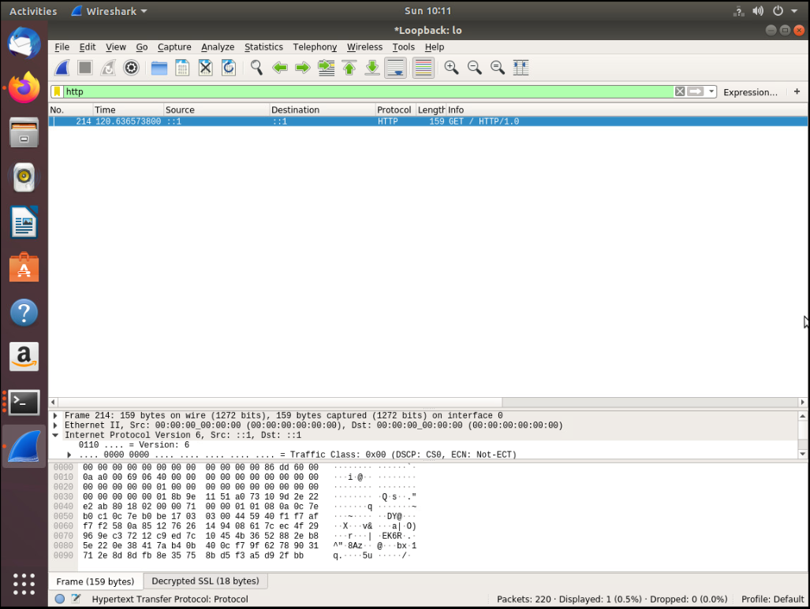
Creating and testing an SSL/TLS file
This screenshot shows the HTTP GET request in the Info column.

Slide 8
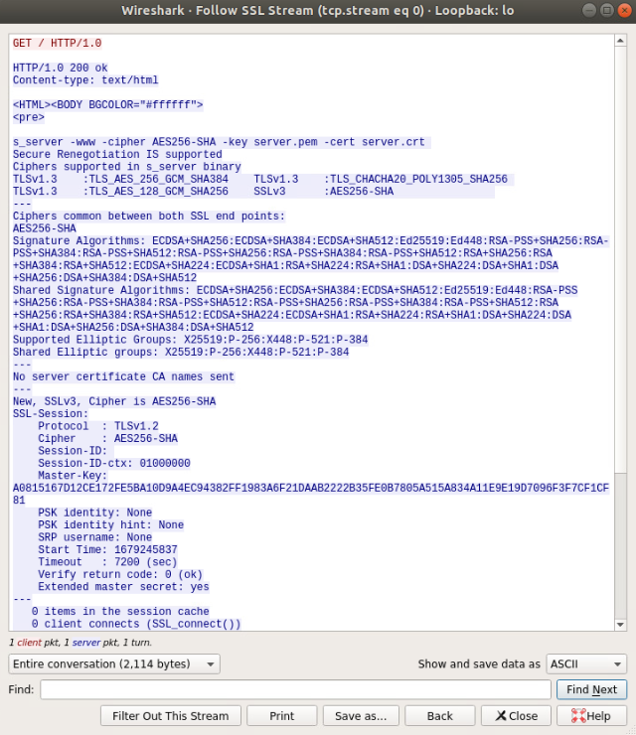
Creating and testing an SSL/TLS file cont’d
This screenshot shows the decrypted SSL stream.

Slide 9
References
Chapple, M., & Seidl, D. (2020). CompTIA CySA Study Guide Exam CS0-002 (2nd ed.). Wiley Professional Development (P&T). https://devry.vitalsource.com/books/9781119684114
Course notes and Project video

Slide 10
Snort Open-source Network Intrusion Detection System

Slide 11
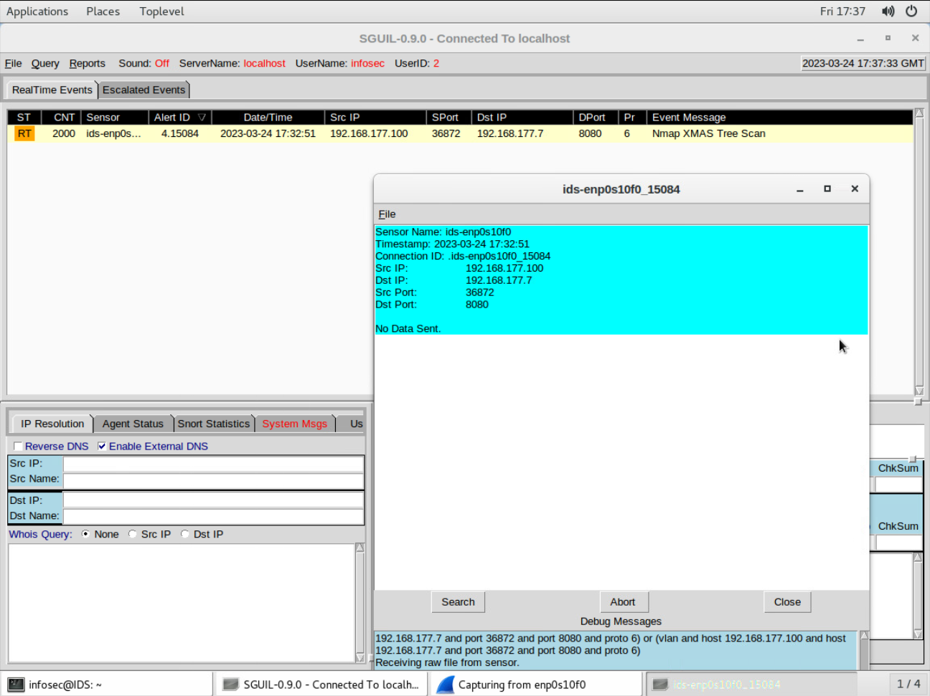
Testing Snort rules
This screenshot shows the transcript of the XMAS scan alert.

Slide 12
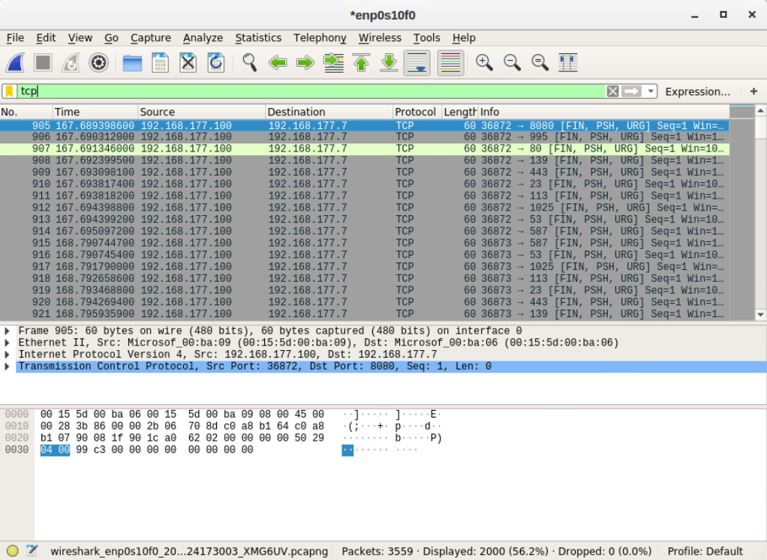
Testing Snort rules cont’d
This screenshot shows the TCP packets generated by the XMAS scan.

Slide 13
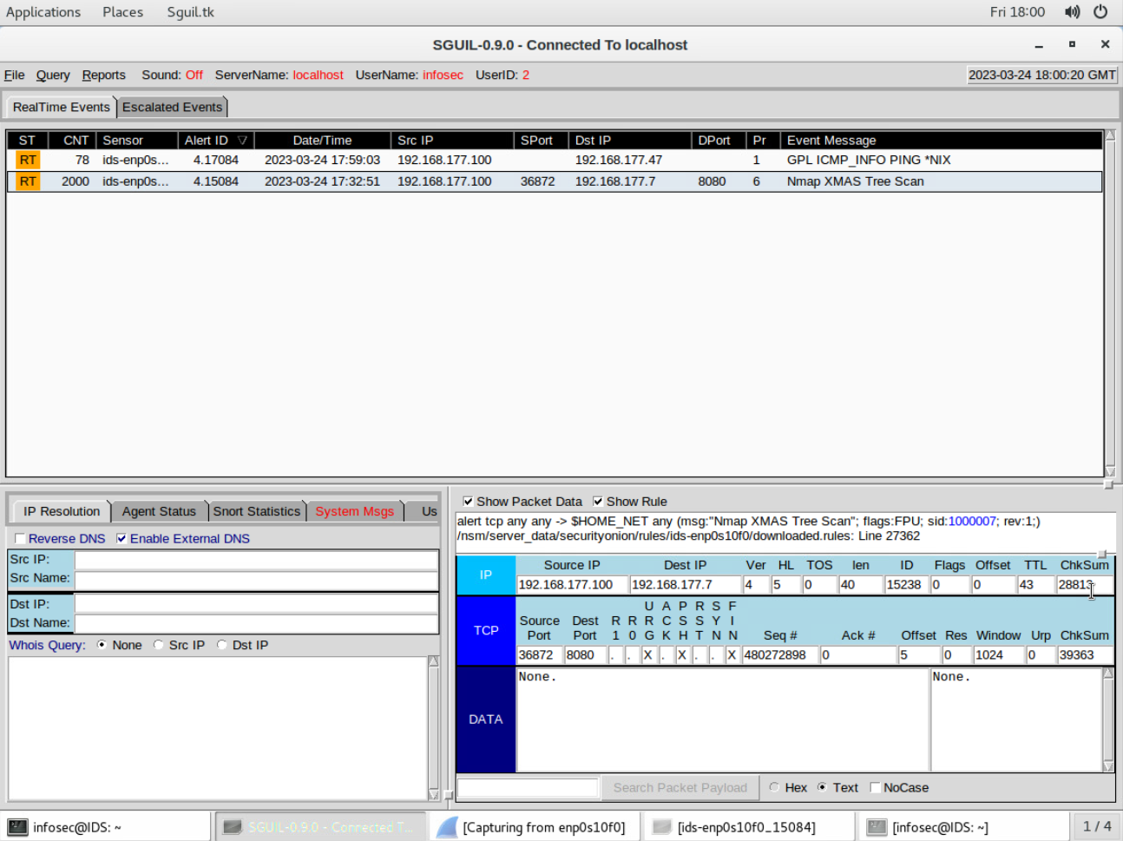
Creating Snort rules
This screenshot shows the ping activity alert.

Slide 14
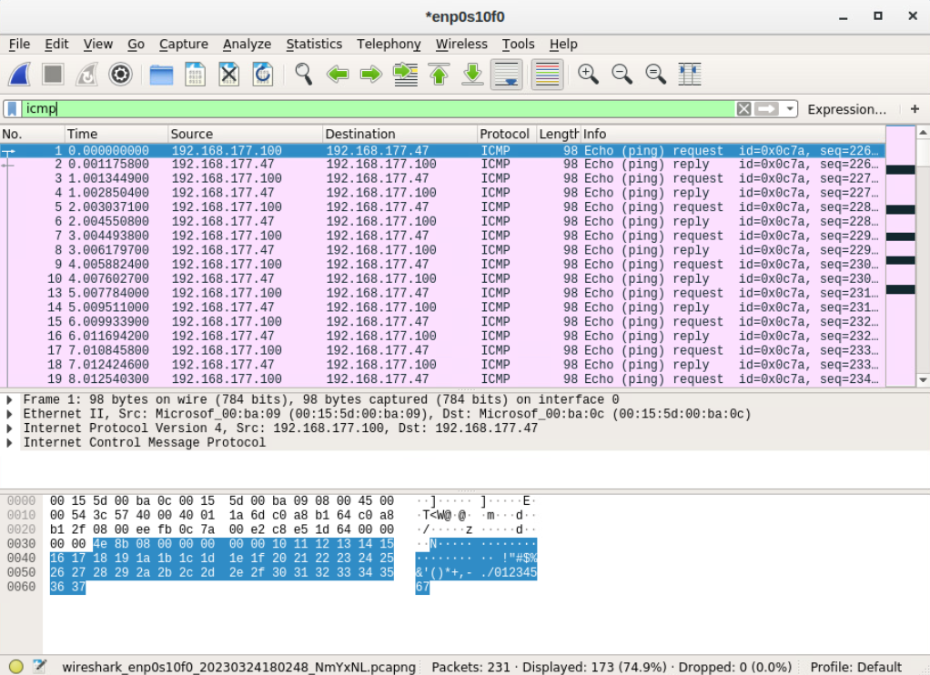
Creating Snort rules cont’d
This screenshot shows the ICMP packets generated by the ping activity.

Slide 15
Live Memory Analysis

Slide 16
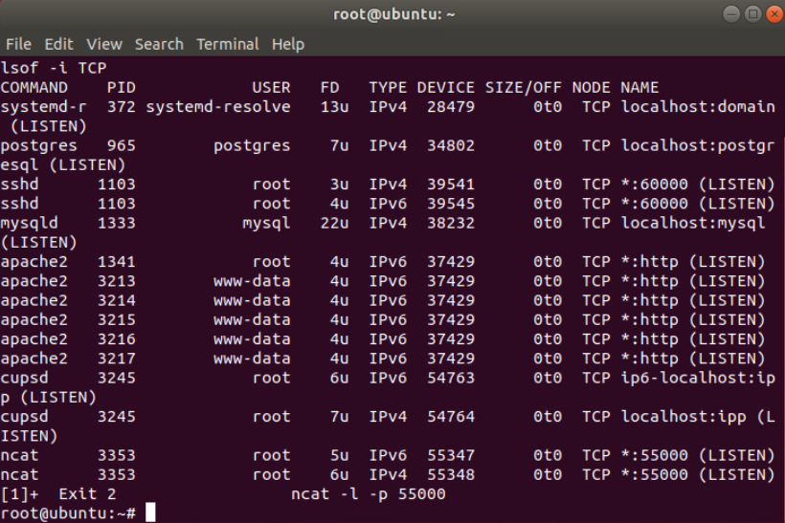
Linux Processes
This screenshot shows port 55000 open for both IPv4 and IPv6.

Slide 17
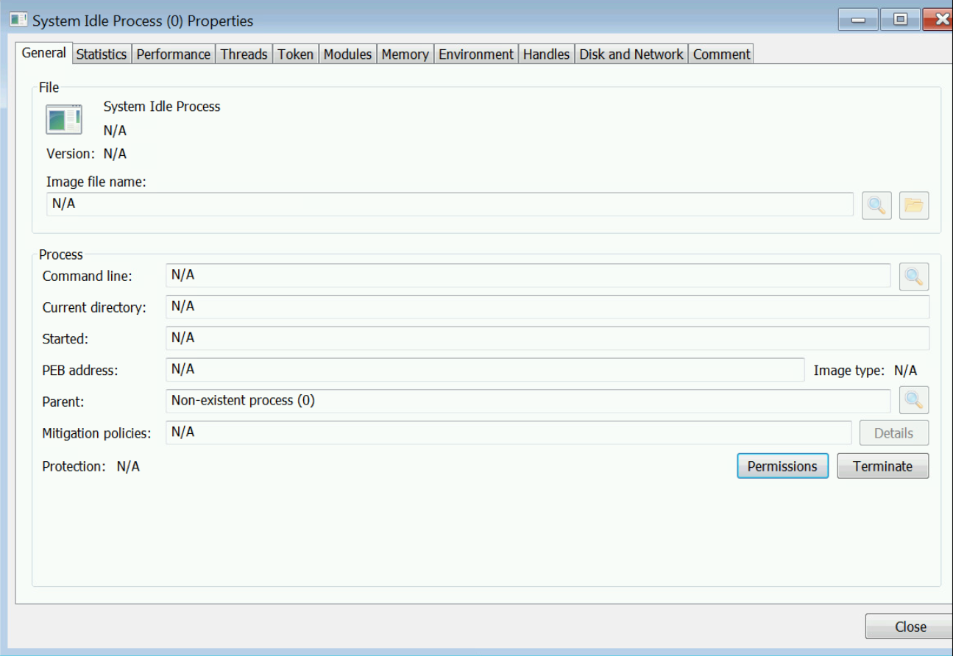
Process Hacker
This screenshot shows where the properties of a chosen process would be located.

Slide 18
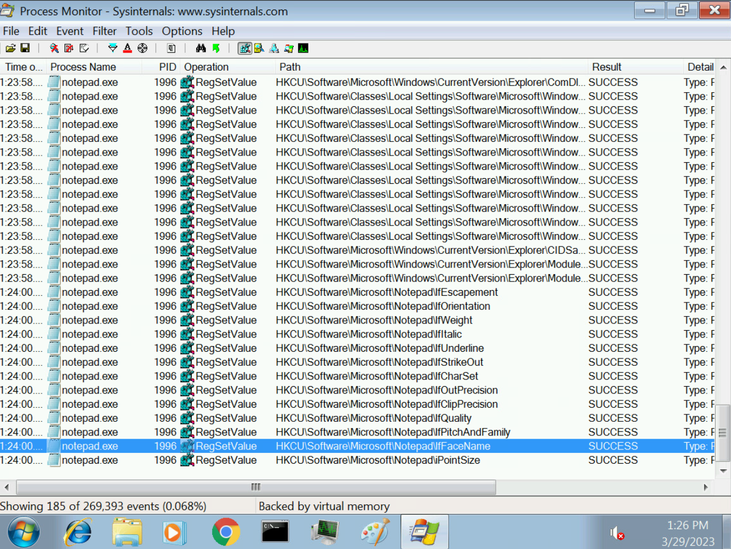
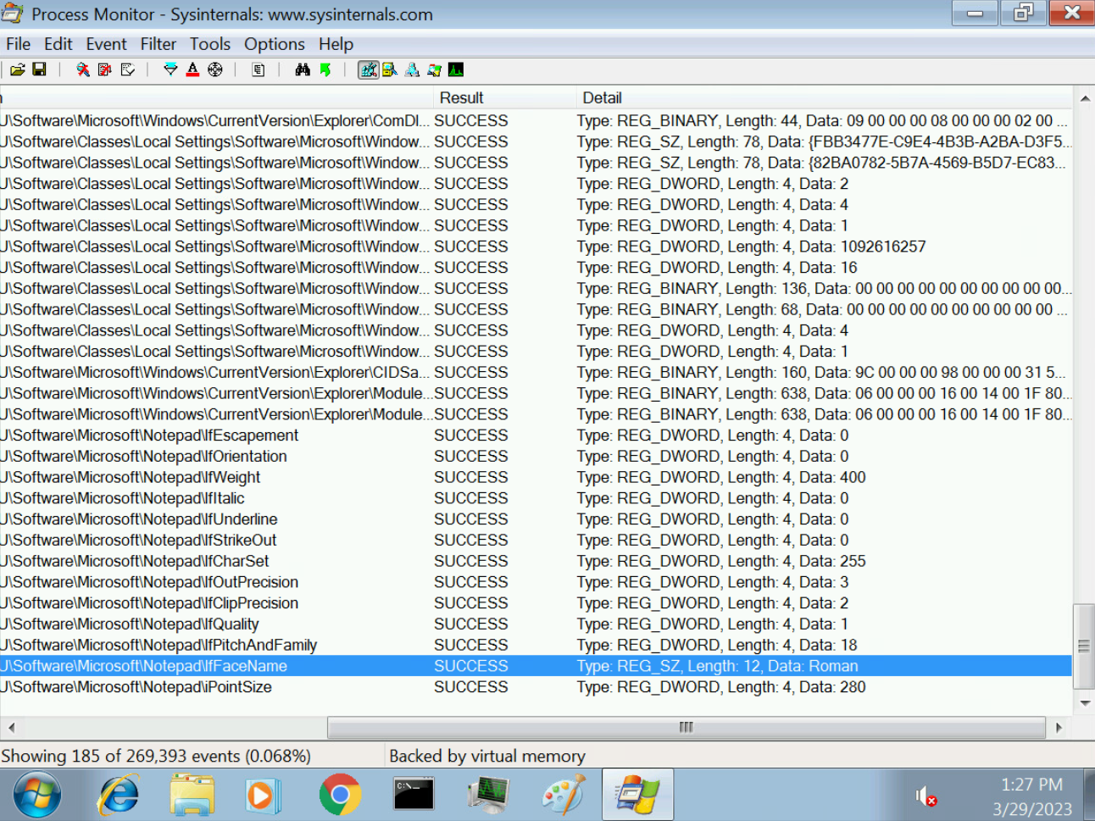
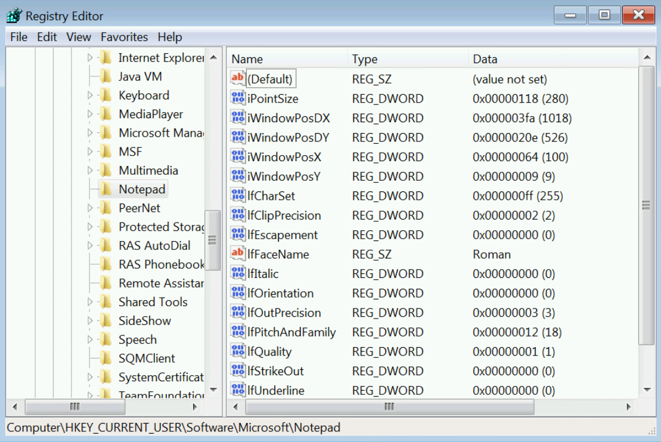
Process Monitor
This screenshot shows ifFaceName in the Path column and Data: Roman in the Detail column.

Slide 19
References
Chapple, M., & Seidl, D. (2020). CompTIA CySA Study Guide Exam CS0-002 (2nd ed.). Wiley Professional Development (P&T). https://devry.vitalsource.com/books/9781119684114
Course notes and Video

Slide 20
Iptables for Network Defense

Slide 21
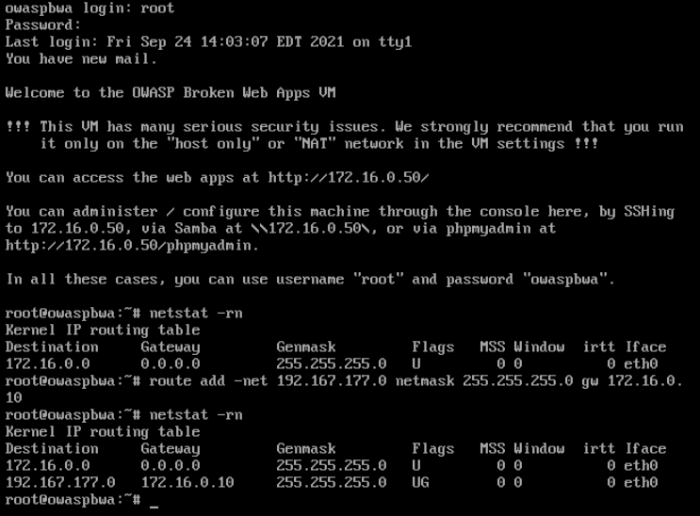
Time-based Access
This screenshot shows the output of the DMZ Route Table.

Slide 22
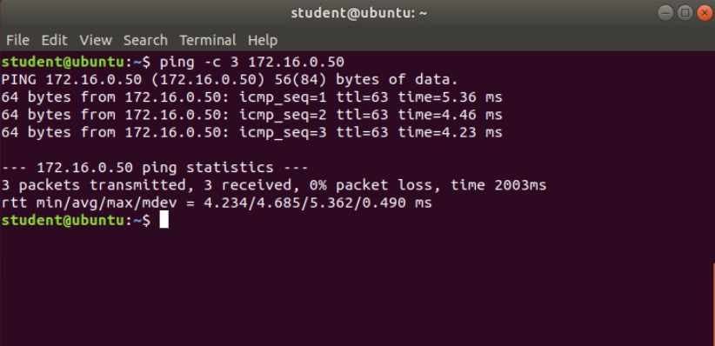
Time-based Access
This screenshot shows a successful ping from the Ubuntu Web VM and the DMZ VM.

Slide 23
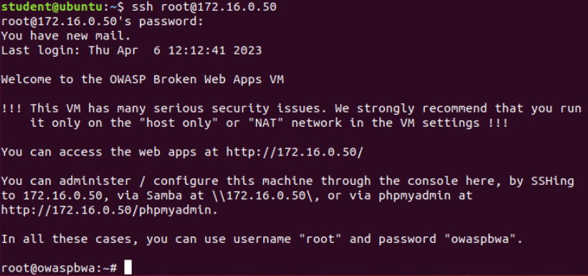
Time-based Access
This screenshot shows two time-based access rules in the FORWARD chain

Slide 24
References
Course notes and Lecture
Chapple, M., & Seidl, D. (2020). CompTIA CySA Study Guide Exam CS0-002 (2nd ed.). Wiley Professional Development (P&T). https://devry.vitalsource.com/books/9781119684114

Slide 25
Challenges And Career Skills
This course addressed a wide range of sophisticated concepts that were difficult to comprehend and work through at times. For example, while we were going through the Snort lab, I was having trouble getting the rules to operate correctly. I was able to address these difficulties by restarting the lab and paying closer attention to the instructions. The use of virtual labs helped solidify the information which made understanding the topics easier. Such challenges aid in the development of basic job skills such as systematic problem-solving and critical thinking.

