Slide 1
Ceis110 final project
By Kevin Foxen

Slide 2
introduction
This project illustrates the use of the Python programming language utilizing the Anaconda/Spyder IDE as well as Microsoft Excel and SQL. The goal of this project was to Develop a program to download our local weather data from the NOAA website. Once we had the data available, we were able to analyze the data and analytics, develop charts, and derive predictions based on weather trends.

Slide 3
Flowchart
Install python
Download weather data to a database.
Extract weather data from database into a comma separated file with python
Cleanse weather data
Use Excel to manipulate data
Use python data analytics modules to develop graphical models

Slide 4
Software Inventory
screenshot of NOAA-SDK library installed
Result of successful install of the “NOAA-SDK" using pip installation command.

Slide 5
Downloading weather data

Slide 6
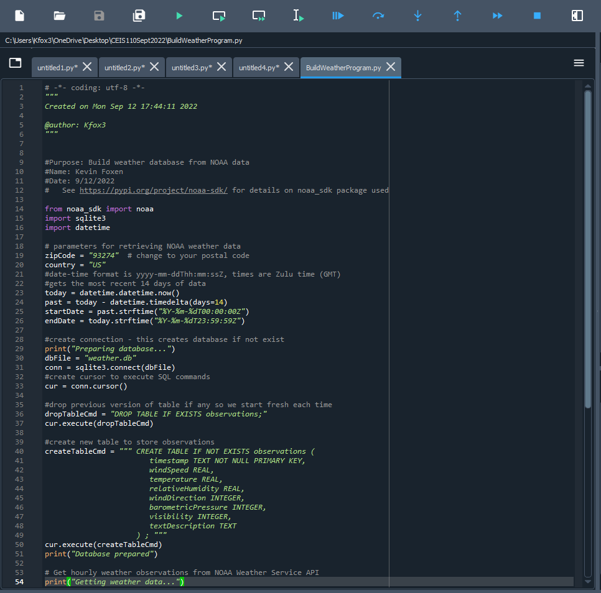
BuildWeatherDb.py Code (Screenshot)
Screenshot of code in Spyder IDE
name and date in comments
local zip code

Slide 7
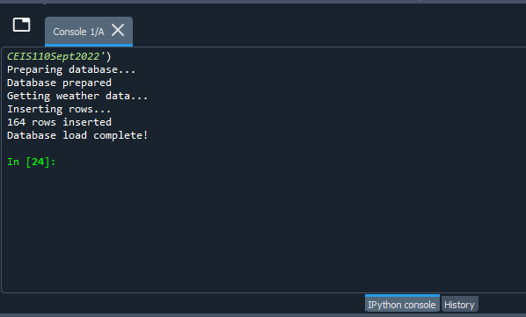
Python Console (Screenshot)
Screenshot of program output in Python console showing program executed successfully

Slide 8
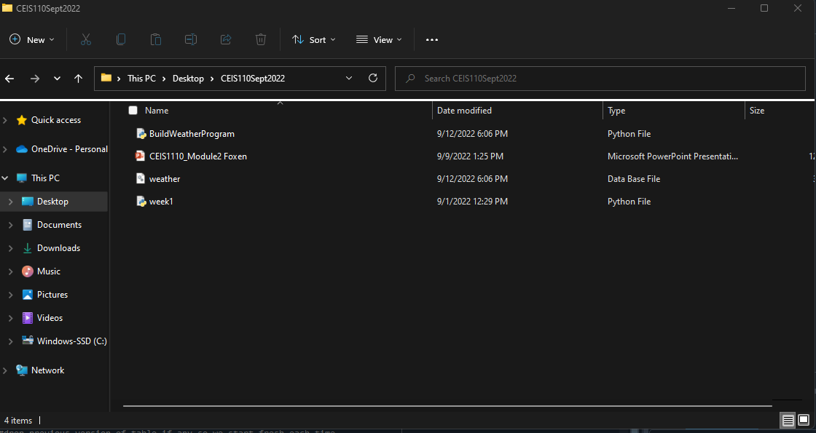
Weather. dB File (Screenshot)
Screenshot of Windows Explorer showing database file Weather. dB was created

Slide 9
Querying the database with SQL

Slide 10
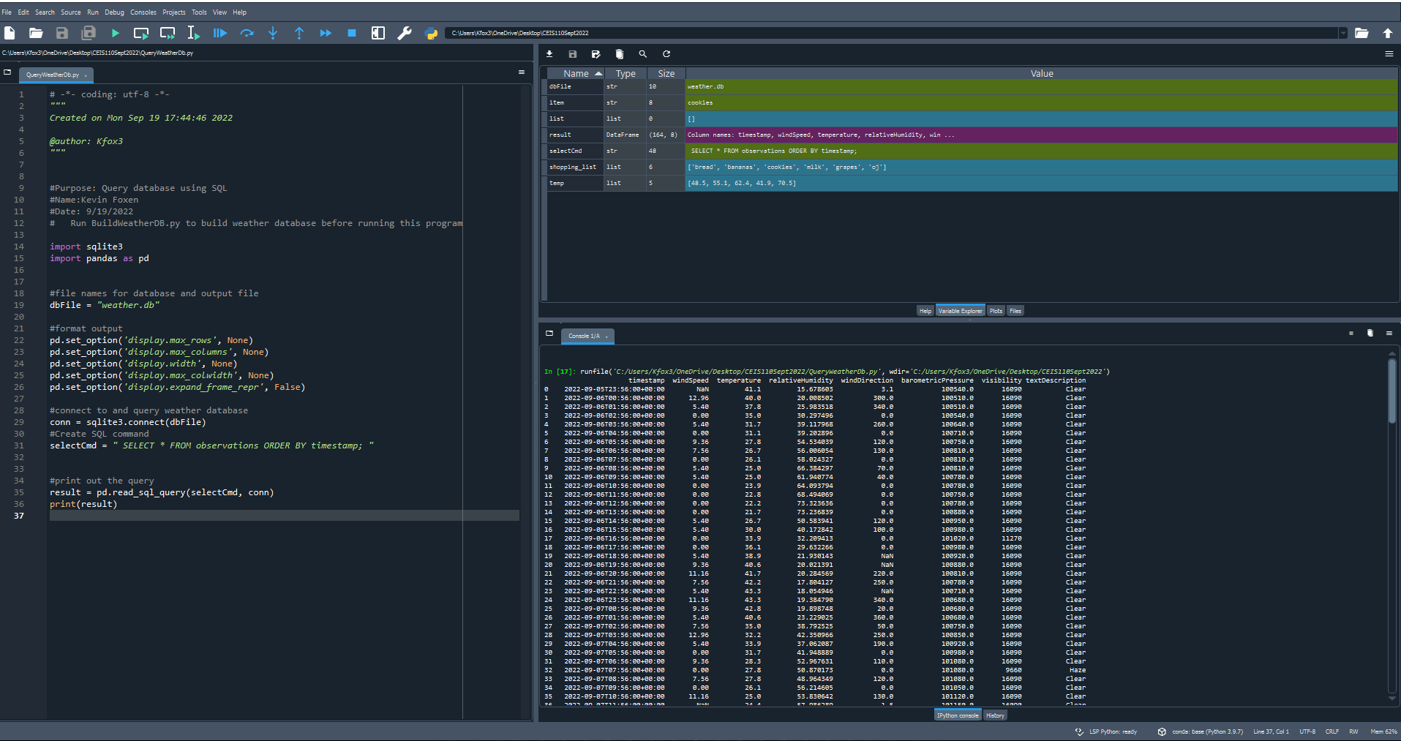
Query to retrieve all columns and all rows (Screenshot)
Screenshot of SQL query command and results

Slide 11
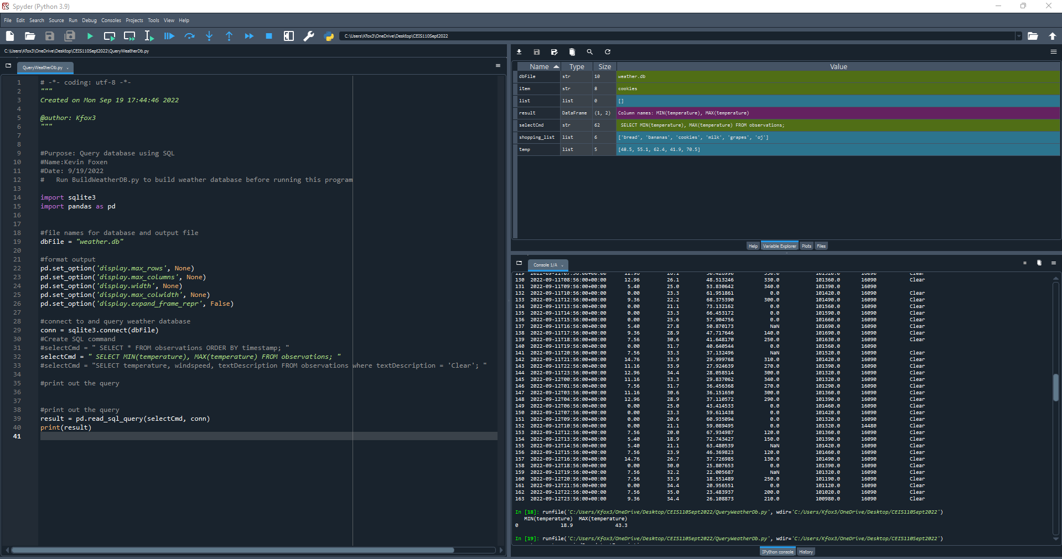
Query to retrieve lowest and highest temperatures (screenshot)
Screenshot of SQL query command and results

Slide 12
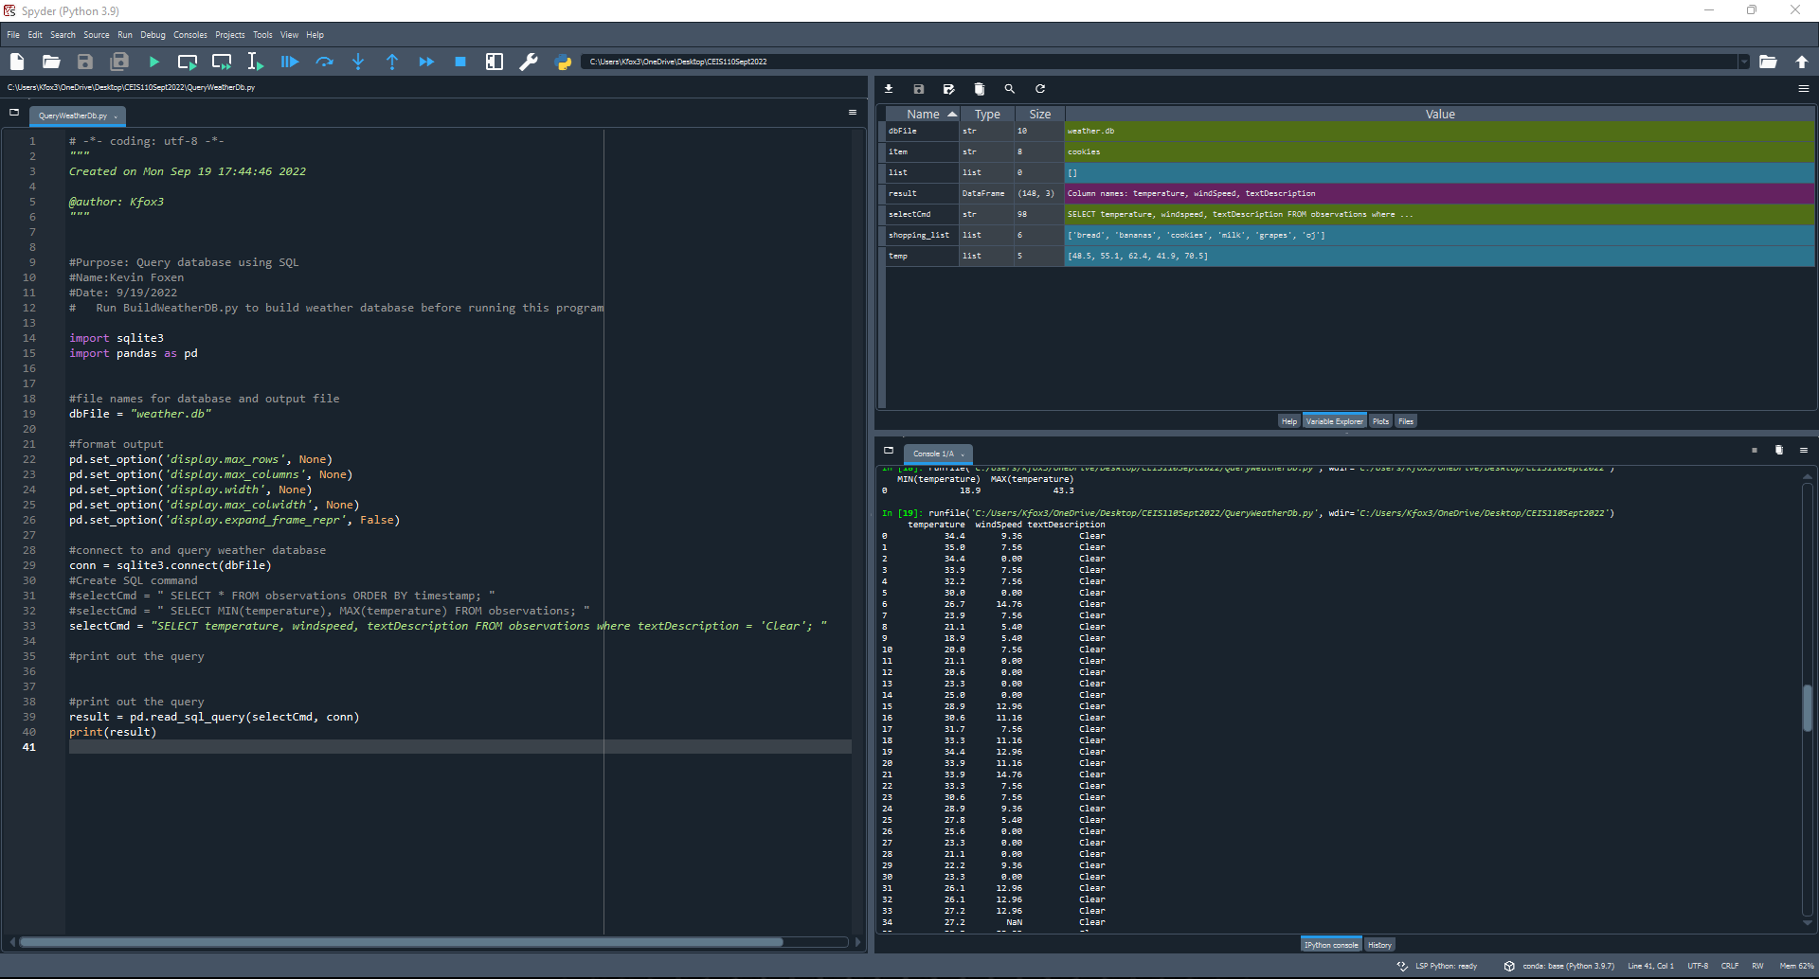
Query to retrieve all clear days (screenshot)
Screenshot of SQL query command and results

Slide 13
Querying and manipulating data with SQL and Python

Slide 14
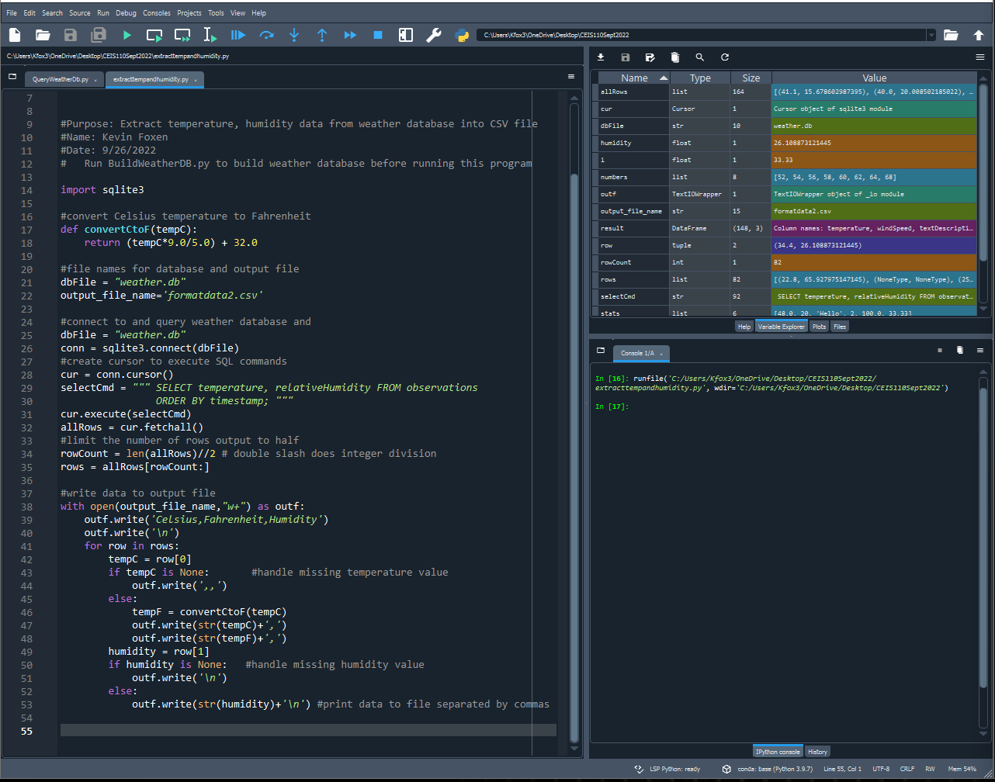
Python code (Screenshot)
ExtractTempHumidity.py Python code

Slide 15
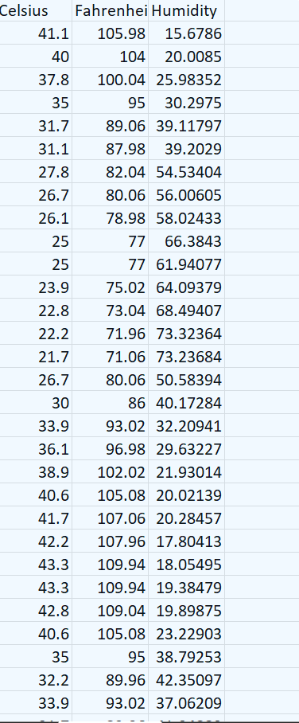
Retrieve and Convert Data to CSV Format (Screenshot)
The formatdata.csv file open in Excel shows 3 columns of data Celsius, Fahrenheit, and Humidity.

Slide 16
Temperature and Humidity Chart (Graph)
Excel chart based on the temperature and humidity data from the database

Slide 17
Develop Graphical Models and Interpret Results

Slide 18
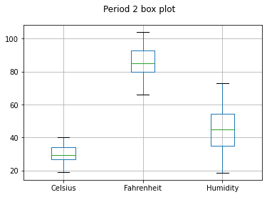
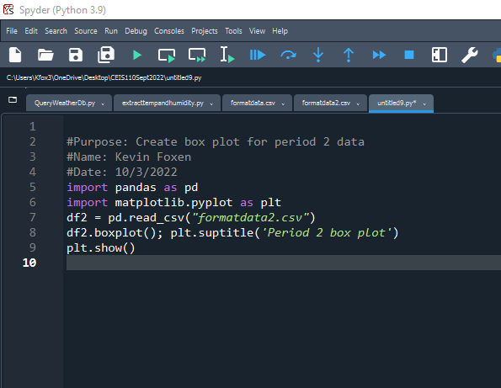
Plot #1
Box plot comparing Celsius, Fahrenheit, and Humidity using formatdata2.csv file.

Slide 19
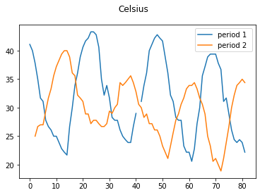
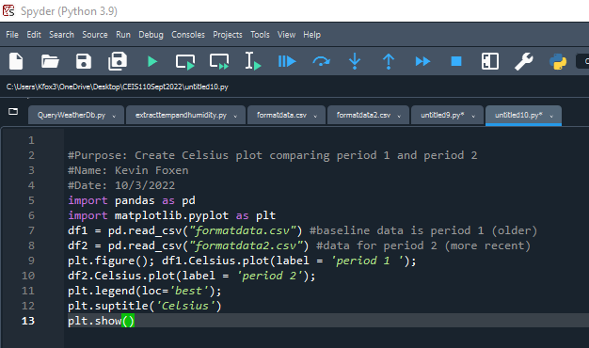
Plot #2 (Screenshots)
Line plot and code used to generate a graph comparing data from both formatdata.csv files

Slide 20
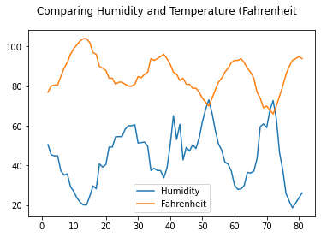
Analysis
The chart illustrates that the change in humidity is affected by the increased temperature.

Slide 21
Prediction
Based on the analysis of the recorded data, the temperature will continue to increase, and the humidity will continue to drop over the next few days.

Slide 22
conclusion
This course was a great introduction to the Python programming language and has inspired me to learn more about the program’s endless possibilities. I don’t have plans to become a Program Developer, but I think that this type of programming language fits my intended path of Network engineering and Cyber Security well. I feel confident that I now have the skills necessary to read through Python and similar program code/ scripts and recognize what the intended outcome is supposed to be.

Slide 23
challenges
Most of the challenges that I faced while working on this project were syntax-based errors. There had been several occasions where I had forgotten to add a colon or indention which would not allow me to run the code. This type of setback has made me a better programmer by forcing me to become more systematic and detail-oriented with my coding.

Slide 24
Career skills
Learning a programming language such as Python or any other language builds a combination of fundamental skills and soft skills. I learned the fundamental skills of IDEs, Libraries, loops, variables, and strings, and how and when to use them. Some soft skills that I was able to build upon included things like critical thinking, having a systematic approach to diagnosing and creating code as well as just becoming a better problem solver.

