Slide 1
CIS355A COURSE PROJECT FINAL
BY Kevin Foxen
April 10th 2024

Slide 2
Introduction
Java is a versatile, object-oriented programming language widely used for developing high-performance enterprise software and mobile applications. Its platform independence, strong memory management, and extensive libraries and APIs make it ideal for creating complex applications. In the following presentation, I outline the steps I took to create a GUI application for a prospective landscaping client. This includes understanding the client’s needs, designing a user-friendly interface, and implementing the required functionalities, showcasing Java’s practical applications.

Slide 3
Design phase
The design phase is critical to saving time.
The client can view the documents and modify changes early in the project.
Wireframe diagram provides a basic outline and target to achieve.
UML Class diagram provides the structure for our application.

Slide 4
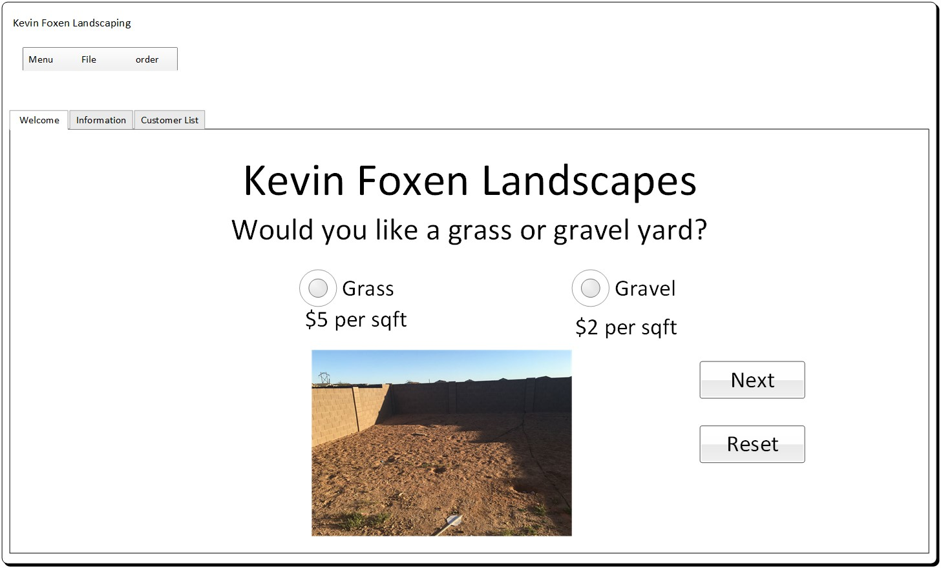
Wireframe Diagram
GUI design using Visio
Component layout to be used
Layout for the screens
Basic functions

Slide 5
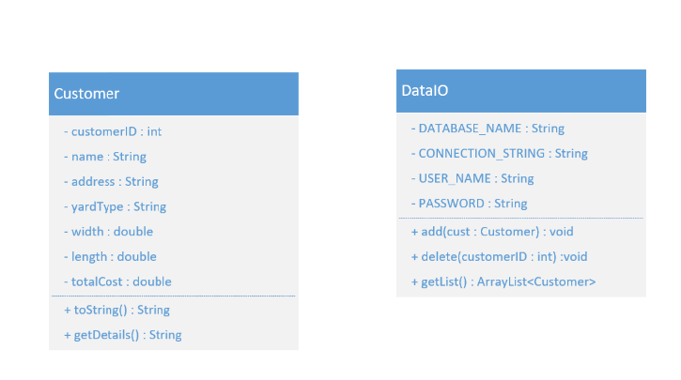
UML Class Diagram
Designing classes to be used
Creating structure
Determine public and private data
Determine data types
Determine basic methods

Slide 6
Simple GUI Application
I have created a simple GUI with three tiers. The welcome tab presents landscape options for customers to choose from. On the information tab, customers can provide their details, calculate the order, and then submit it. Lastly, on the customer list tab, the client can retrieve customer information from the SQL database by making queries.

Slide 7
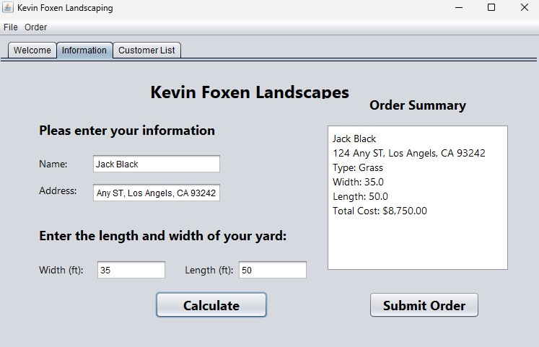
Simple GUI
Labels
Text Fields
Text Area
Buttons
Event handlers

Slide 8
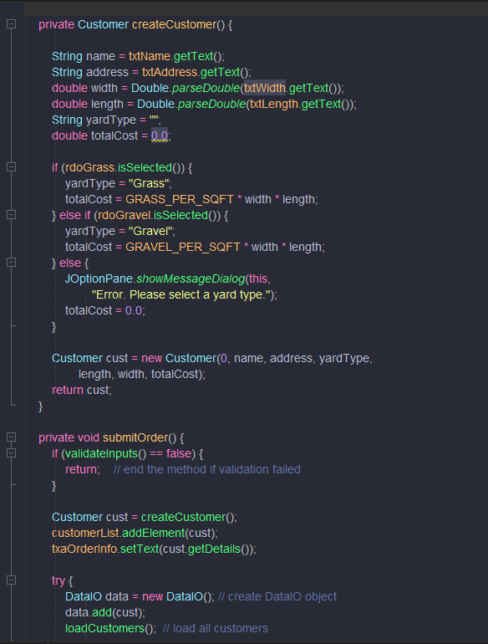
Event Code
Code defined into methods
Write once, run everywhere!
Pull input from text fields
Process input
Show desired output

Slide 9
Tabs JList and ArrayList
Created new tabs using Tabbed Pane
Created an ArrayList for Customer List text box
Add radio buttons and button group
Added functionality

Slide 10
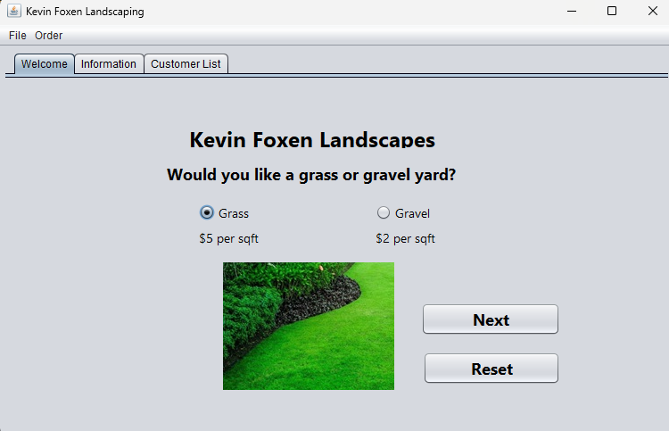
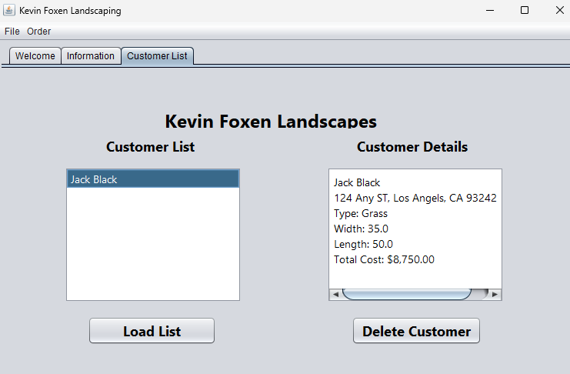
Tabbed Panes
Tabbed pane
Added radio buttons and button group

Slide 11
Read and Write to Files
Write data from the GUI to a txt file
Read data from file and display the data on the GUI application
Use DataIO UML structure to create classes and methods

Slide 12
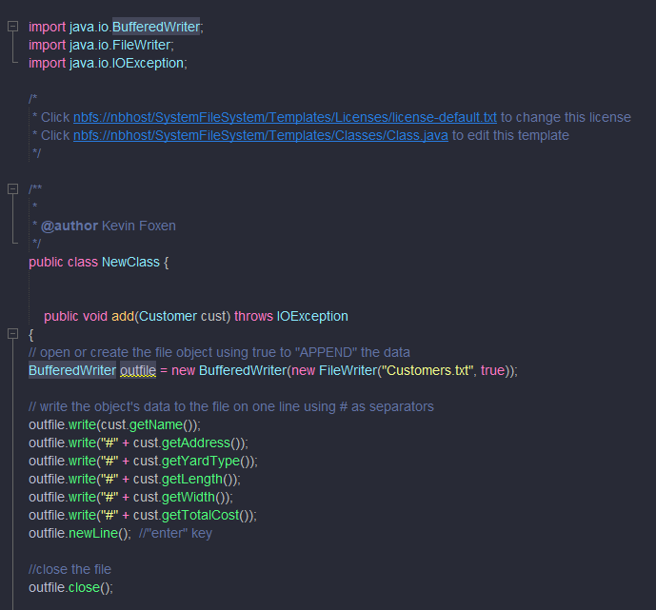
Read and Write to File system
Created txt file to write to
Implemented Buffered writer
Created necessary methods

Slide 13
Create Database
Create project database using MySQL
Modify existing DataIO Class to read and write to the database instead of txt file.
Import appropriate driver to allow communication to the database

Slide 14
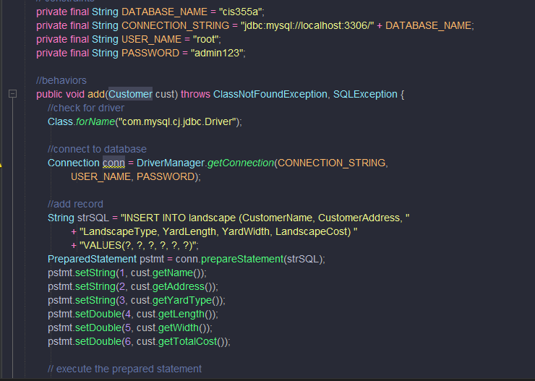
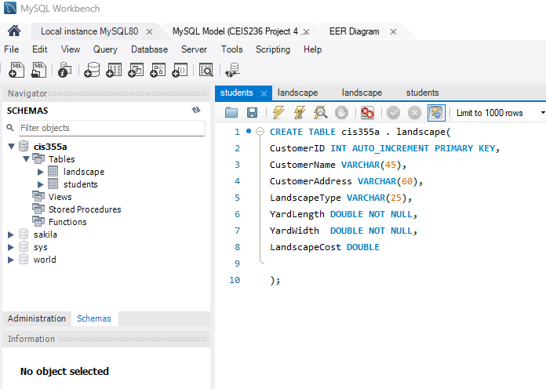
Read and write to SQL database
Create Simple SQL database
Data base connection

Slide 15
Challenges
Java code is case-sensitive and does not support features like pointers.
Some errors required debugging and a fair amount of research to correct.
Error handling IOException became a requirement using Try Catch statements.
Alignment issues can be problematic and require trial and error.

Slide 16
Conclusion
Over the past few years, I have gained proficiency in various programming languages, including Python, C#, and MsSQL. Among these, I find Java to be exceptionally adaptable and robust, suitable for a wide range of development scenarios. Interestingly, Java shares some syntactical similarities with C#, which can significantly ease the transition between the two languages and reduce the learning curve.

